Slide 1
CUSTOMER – PROJECT NAME
Customer Location
Go/No-Go
Salesforce ID:
RFP No.:
Date:

Slide 2
Customer - Project Name
Customer Logo
COMMERCIAL & EVALUATION CRITERIA
Deal Overview
What are the conclusions arising from the commercial evaluation criteria for the project?
What will the customer evaluate for choosing the winner?
Lowest Cost
Technical Score
Schedule
Project Strategic Relevance To The Customer: Is there a clear need for this project and if so, what is it?
PROJECT OVERVIEW
General info about the project: Location, greenfield/brownfield, km/miles, RR type (Light Rail, Heavy-Rail, Commuter, etc),
System Type (PTC, CBTC, ATP, etc), Background info, Financial Info (funded?, how much to spent in the project vs desired scope), etc…
Cyber security required?
Schedule/Project Duration/Milestones
(refer to an existing schedule if available)
Bid budget: Total ($); Wabtec share($)
DBE/SBE Goal:
PIC/MAP/COSTUMER
Picture to illustrate the project and scope
POTENTIAL COMPETITORS
Competitor 1 – H/M/L
WINNING STRATEGY
License of the Selling Entity to operate and/or to execute the work in the State/City/County where the project will be executed : (Xorail / WTS Canada / WRE / WTS LLC / or maybe other entities depending on the location of the work)
Does Wabtec have any cost advantage?
Value engineering
What differentiates us?
Commercial Relationship
Execution optimization
Potential Partnerships (If Prime why and who would be the Subs), (If Sub to what Prime to work with and why?)
SBE/DBE strategy
Etc
SCOPE SUMMARY
Relevant info on the scope, potential desired scope, packages, etc…
Historical relevant info: existing system/supplier in place, etc…
Any incumbent equipment/systems supplier…
Is a Maintenance System Agreement (MSA) expected with the proposal?

Slide 3
Customer - Project Name
Customer Logo
Deal Overview
CP0 Checklist
RISK AND OPPORTUNITIES
1 | Have we worked with this customer previously? Do we have any current contracts? Any major challenge? | Describe the project and how the experience was including payment challenges.Please work on the assessment for both End customer and/or Prime.
2 | Is the deal structure clear? Which are the entities engaged? Is this the most efficient deal structure? | Describe the deal structure: Wabtec as subcontractor or Prime, which entities to be used, whenever applicable review with tax team
3 | Did we have problems in any previous contracts with this Customer? | Please analyze this from Prime and End Customer standpoint if applicable.
4 | Does the scope require a subcontractor? Is the Scope Split clear? Is the subcontractor identified? | Who will oversee the scope definition and technical validation of the proposal scope and Price ( Name the professional) Inform DOA approver for the subcontractor ( same as Deal approver)
5 | Is the Technical Proposal leader identified? | YES/NO … inform name of the ASSIGNED LEADER
6 | Have we identified key resources to lead the proposal development? | Please list CommOps leader, PM, Proposal technical leader, key segment leaders, etc.
7 | Is there consensus within the customer organization for the approach and scope of project described? Is there a formal Technical requirement? | If no customer formal requirement specify how we will handle the scope alignment with customer.
8 | What is the Customer Decision Process? | Describe the decision process and timing ( board approval? Budgetary first and then firm? Any other specifics from the customer?)
9 | Is the Customer Budget available | Yes/No, describe any challenges or if Wabtec is required to support any approval process.
10 | What is the political environment / drivers? Is there a particular event of political pressure underlying this project? | Example: Olympics Games? World cup? Schedule commitments?
11 | Cyber Security Requirements: Is there a need to start CARA or CATO processes? | Detail your answer. Inform the person in charge to open the tickets.
Category | Statements | Comment | Action
Technical
Risk | Signaling technology to be provided by Ansaldo | We will need to work with Ansaldo to be competitive
Opportunity | We are working with GLX for Green line Extension | This will help us have onhand experience on MBTA network
Risk | Turnkey Bid | Other bidders can offer same solution
Commercial
Risk | T&C’s exposure— LD’s, Overall Liability, Professional Liability, consequential damages | Will discuss this with customer during pre-bid meeting and get clarification. | Draft specific questions to customer.
Pipeline
Risk/Opportunity | What is our current pipeline? Does this align well, timing, etc? Is this Opp realistic & achievable?
CONTRACTS OVERVIEW – T&Cs
Contracts and CommOps should utilize CRT and list the items to be discussed (deviations from Wabtec’s policy)
Commercial Risk Tool
What are the conclusions arising from the expected Terms & Conditions for the Project?

Slide 4
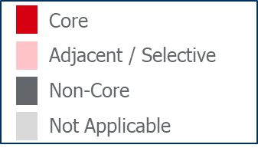
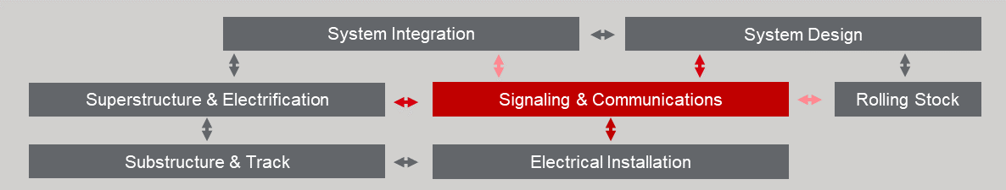
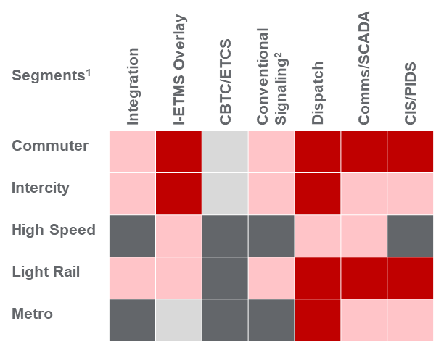
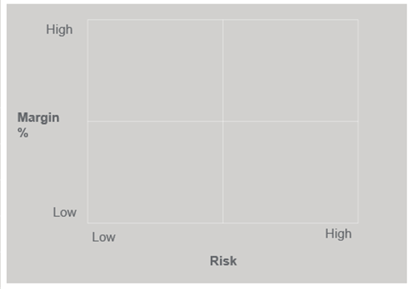
DEAL FRAMEWORK EVALUATION
Assess Opportunity Attractiveness to guide Go/No-Go Decision
Opportunity Landscape
System Responsibility & Interfaces
Contracting Model & WAB %: place check mark where appropriate for this deal on both tables
place check mark(s) where appropriate for this deal across this image
Type | Prime | Sub
Design-Bid-Build
Design & Build
Design-Build-Finance
Other (write in)
WAB Cost % vs Total
> 40%
25 – 40%
< 25%
Example of filling
Partner Selection: place check marks where appropriate for this deal
Type | Proven | Unproven | Discussion Topics
WAB Direct to Customer |  |  | T&C’s, Eval. Criteria
WAB Direct to a Prime |  |  | Rational v competition
Subs to WAB |  |  | Scope & Risk mgmt
Technology by Segment
Opportunity Risk vs Reward
place check mark(s) where appropriate for this deal across this image
place dot for each technology on this deal across this image
Prime rationale: why selecting the Prime(s) chosen?
Subs rationale: why selecting the Sub(s) chosen?
Competitive Position: place check mark(s) where appropriate for this deal (add row if needed)
Conventional Signaling
Entity | New Entrant | Mkt Presence | Incumbent | Annual Rev $’s
Wabtec
Partner A
Partner B
Partner C
N/A
$x
$x
$x

Slide 5
Customer - Project Name
Customer Logo
  ROLES AND RESPONSIBILITIES
Deal Overview
Need to be Assigned
Scope of Work | Wabtec | Sub/Prime
Proposal technical leader | Lead
Manage Customer Contract | Lead | Support
Project Management | Lead | Support
System Requirements & Conceptual Design | Lead | NA
Wayside Design (incl Application Data Prep) | Lead | NA
Control Centre Design and Adaptation | Lead | NA
Communication | Lead | NA
Signaling Construction and Instalation | Support | Lead
Procure | Lead | NA
...
...
ADDITIONAL PROPOSAL INFO
Type of Bid: (Firm Fixed Price, Time/Material (T&M), Design-build, ROM, ...)
Pre-Bid info: Design Status (0%, 30%, Complete, ...)
Site survey info:
Applicable laws/regulations: (Buy America, Davis Bacon, FRA, FTA, USDOT, ...)
Validity
Required Taxes, Insurance, and Bond
CATO or CARA process required?
SEGMENT LEADS
KEY DATES
Signaling Eng team
TBD
Wire Shop Team
TBD
Construction team
TBD
Contracts team
TBD
Communications
TBD
Integration
TBD
CommOps
TBD
RFP Release: XX/XX/XX
Pre-proposal Meeting: XX/XX/XX
Q&A/RFI Deadlines: XX/XX/XX
Wabtec’s Proposal Due: XX/XX/XX
Proposal Due: XX/XX/XX
Anticipated Award: XX/XX/XX
RFP/PROJECT DOCUMENTATION
Project’s folder on Teams: Sharepoint/Teams Link
*Discuss resource capacity and availability

Slide 6
Customer - Project Name
Customer Logo
  ROLES AND RESPONSIBILITIES
Deal Overview
Scope of Work | Segment Leader | Latam | NAM | Sub/Prime
Product Management |  | Lead
ComOps
Signaling
Deployment
Subcontractor
Supply Chain
Office |  | Lead |  | Support
Track DB |  | Lead |  | Support
Onboard |  | Lead |  | NA
Comms |  | Lead |  | NA
Integration |  | Lead |  | NA
Safety Assurance |  | Lead |  | NA
Services |  | Support |  | Lead
PM |  | Lead |  | NA
EHS
Quality & Operational Excellence
ADDITIONAL PROPOSAL INFO
Type of Bid: (Firm Fixed Price, Time/Material (T&M), Design-build, ROM, ...)
Pre-Bid info: Design Status (0%, 30%, Complete, ...)
Site survey info:
Applicable laws/regulations: (Buy America, Davis Bacon, FRA, FTA, USDOT, ...)
Validity
Required Taxes, Insurance, and Bond
CATO or CARA process required?
KEY DATES
RFP Release: XX/XX/XX
Pre-proposal Meeting: XX/XX/XX
Q&A/RFI Deadlines: XX/XX/XX
Wabtec’s Proposal Due: XX/XX/XX
Proposal Due: XX/XX/XX
Anticipated Award: XX/XX/XX
RFP/PROJECT DOCUMENTATION
Project’s folder on Teams: Sharepoint/Teams Link
*Discuss resource capacity and availability

Slide 7


Slide 8
Customer - Project Name
NOTE: This slide must be completed after the meeting and sent to all the personnel involved
Customer Logo
Action Items and Results
Meeting was held on: Friday, October 6, 2023, at 4:30 pm EDT.
Attendees: Wendell Wooten, Aline Walesko Fontes, Charles Forte, Van Fayler, Britt Frerichs, Fernando Lacerda, Patrick Lyle, Dusty Rhoades, Dominic Costello
Results: Go
Example
Action Items:
  Inform Derek Eckhoff of Jay-Reese via phone or text if he doesn’t pick up that it’s a Go.
  Request the latest System Design Doc (SDD). System and Application Eng group should have.
  Contact Jay-Reese and solidify an Exclusive Partnership.
    They are good to go to be exclusive.

Slide 9
Customer - Project Name
Customer Logo
Scope detailed
Signals, COMMS, & Integration
The signaling system provided for the Project by the Design-Builder must be identical to the signaling system of the Capital Line LRT and comply with the Edmonton High Floor LRT Signaling Engineering Manual.
The Design-Builder must fully integrate the signaling system for the Project with the signaling system provided for the Capital Line LRT to prevent operational deadlocking between Century Park Station and Twin Brooks Station.
During tie-in, Design-Builder must ensure the Signal System stays safe and do not create operational disturbance.
Overview
Extending the Capital Line LRT ~4.5KM from Century Park Station
Line crosses high-voltage power transmission lines – EMI/EMC assurance
Include two new stations
  Twin Brooks
  Heritage Valley North
Two Signal Rooms
  At 12 Ave NW
  At Heritage Valley North
Six Grade Crossings – Three (3) at grade street crossings and three (3) ped crossings
  Century Park Bus Access (Ped, no pre-emption)
  Saddleback Rd / 19th Ave & 111 Street NW
  12 Ave & 111 Street NW
  North Ped access to Twin Brooks Station (Ped, no pre-emption)
  9 Ave & 111 Street NW
  Heritage Valley North Park & Ride Access (No pre-emption)
Signal System Description Doc to include Functional description for each application logic and all acronyms
ICD for OCC / Signal Integration

Slide 10
Customer - Project Name
Customer Logo
Relationship - Hierarchy
(Wabtec to possible Primes or Subs and their respective scope)
City of Edmonton
Example
This slide must be done if applicable for the opportunity
End Customer
DBJV
Graham/PCL
TSR
RemCam
Trackwork
Jacobs
Other Subs
Systems Engineering, Design, Assurance, Management
Systems
Wabtec

Slide 11
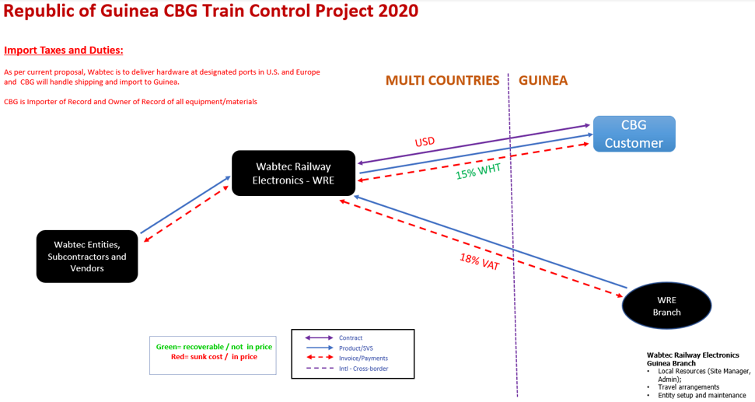
Customer - Project Name
Customer Logo
Relationship - Internal
(Wabtec’s internal legal entity for projects not located in US)
This slide should only be done for opportunities outside the USA
Must include:
Selling Legal Entity
How does the flow of money impact FX, taxes, duties, etc.?
Internal and external relationships with Bus and vendors.
Contract currency.
Example

Slide 12
Customer - Project Name
Customer Logo
Stakeholder Assessment
BLUE SHEET ANALYSIS
Buying Influencers Involved Name, Title Location | Role (E T U C) | Degree of Influence (H M L) | Mode (G T EK OC) | Win – Results Personal Win(s) Business Results |  | Competitive Preference | Rating (+5/-5) | Evidence to Support Rating
Elizabeth Turney Procurement Manager – Colas Rail Edmonton |  | L
Pascal Denis Systems Manager – Colas Rail Edmonton | E T | H
Khaled Maita System Superintendent – Colas Rail Edmonton | T U | M
Key Takeaways:

